Slide 1
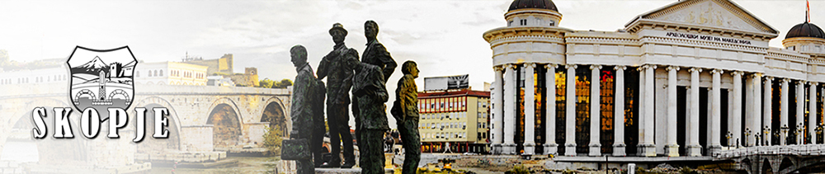
Designing a multimedia webpage for the city of Skopje
A project work by Gjorgjina Cenikj
Submitted to the Faculty of computer science and engineering, June 2017

Slide 2
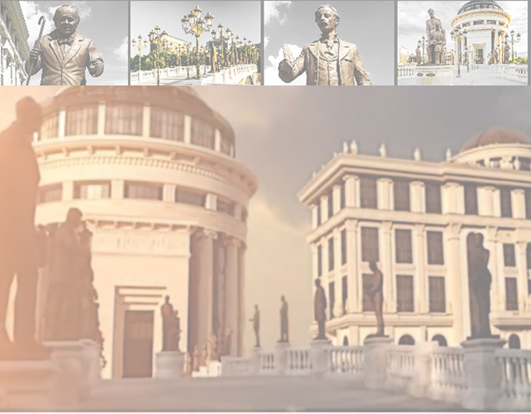
Website purpose:
Purpose:
To present the attractions of the city
To provide useful information for visitors
Target audience:
Upcoming tourists from all demographic groups
Desktop computer users

Slide 3
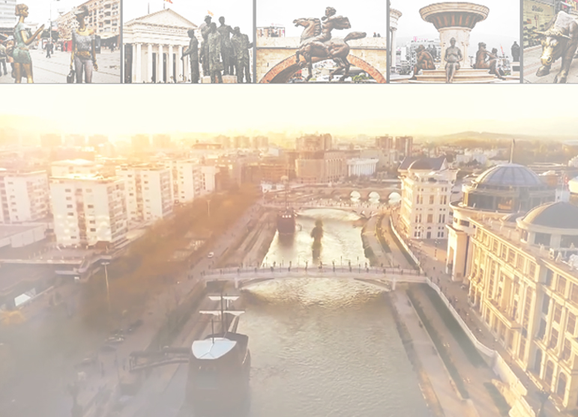
Developed using:
HTML
CSS
Additional tools:
WOW Slider
JavaScript
Adobe Photoshop
Adobe Premiere

Slide 4
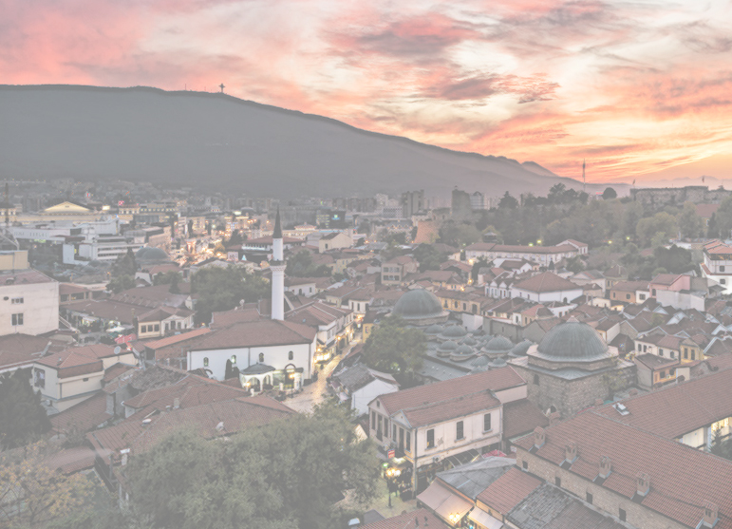
Project phases:
Information Architecture
Interaction Design
Interface Design
Navigation Design
Information Design
Visual Design.
Coding

Slide 5
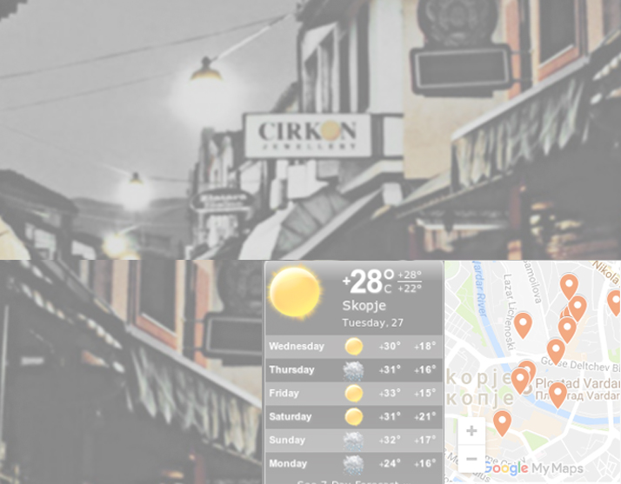
Implementation of:
Google Maps
Google Street view
Google Calendar
Weather forecast
Sliders
Fancybox gallery
Parallax effect

Slide 6
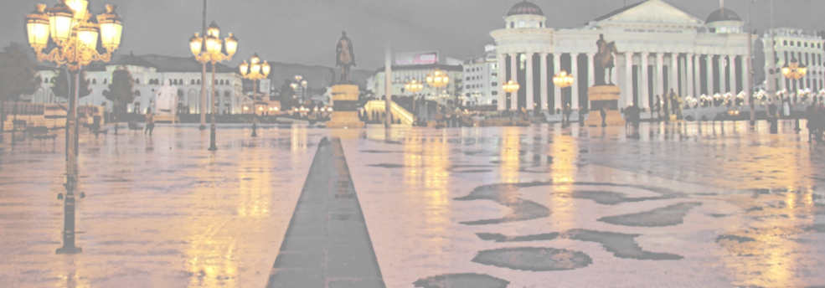
Visual design
The website generally uses 3 colors (2 hues of grey and a vibrant orange), accompanied by patterns of arranging text and undeviating typography to create a hierarchy that indicates the importance of each element.

Slide 7
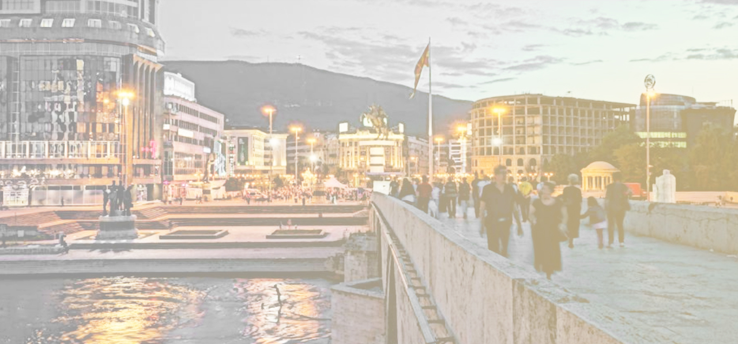
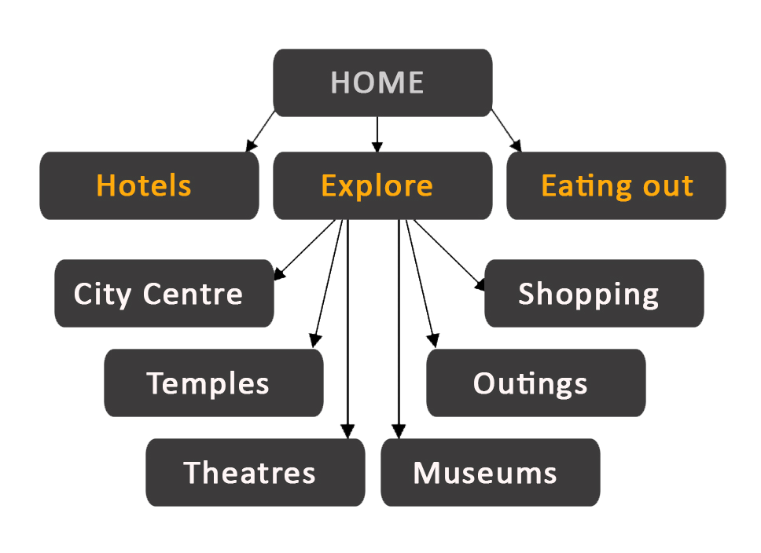
Sitemap
The site consists of 10 pages, 6 of which are grouped as part of the ‘Explore’ page that represents the city’s attractions.

Slide 8
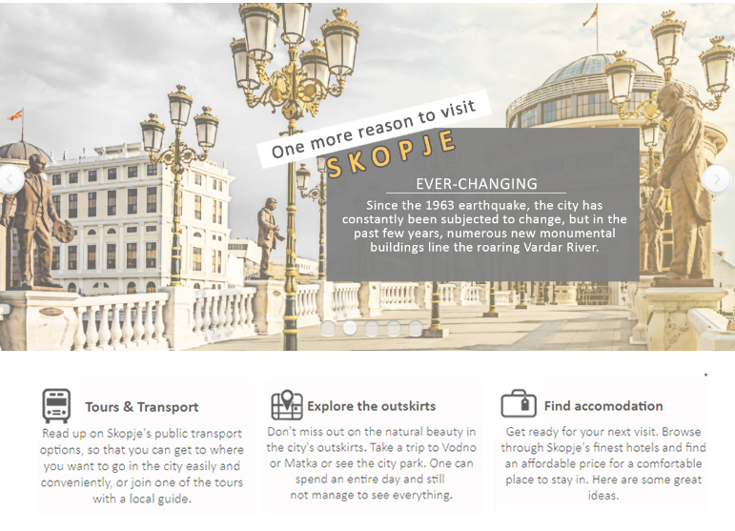
Home page
Eye-catching
Effective
Encourages the user to see the rest of the website

Slide 9
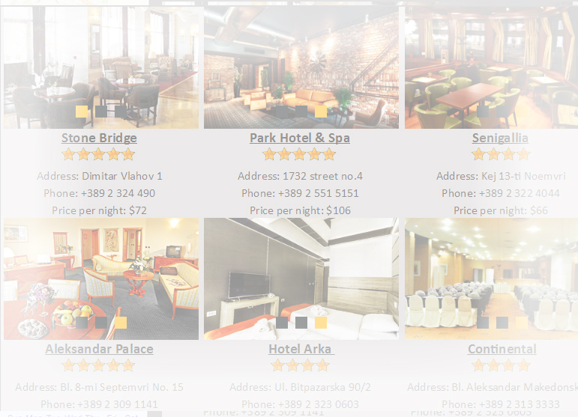
Hotels page
presents the best hotels
includes a small gallery for each hotel, price, ratings, contact info, maps and links to the official websites

Slide 10
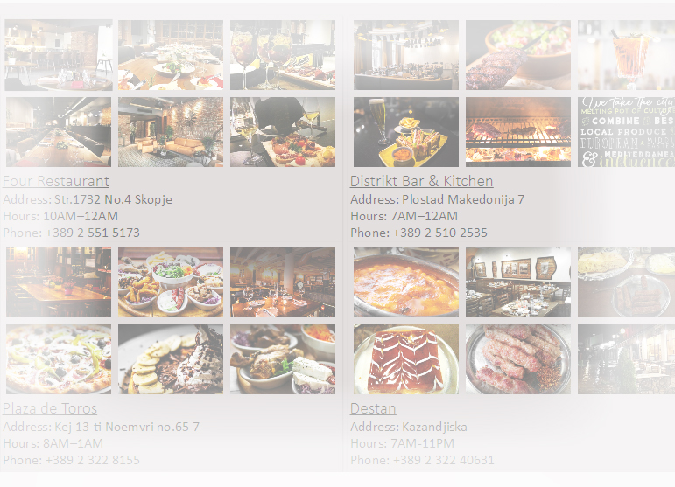
Eating out page
contains 40 restaurants, divided into 4 categories
each restaurant has a 6-photo gallery, contact info and working hours.

Slide 11
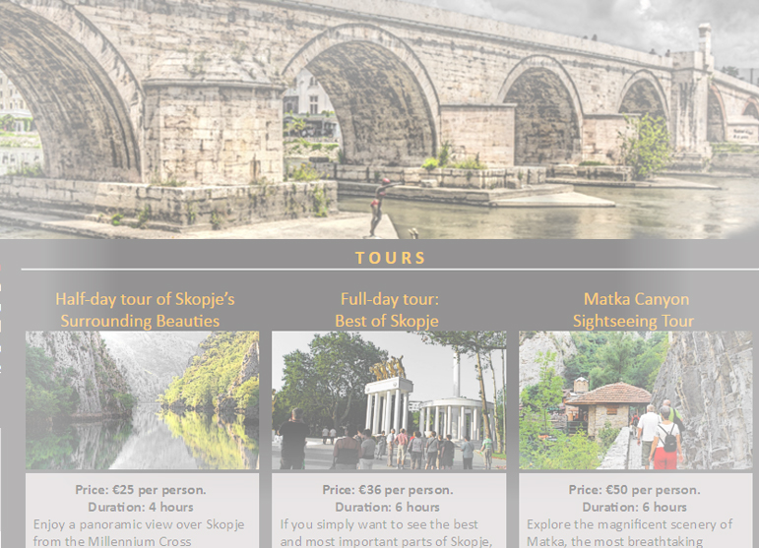
Explore page
information about tours, activities, and transport
introduces popular sights that are represented in detail on the other pages

Slide 12
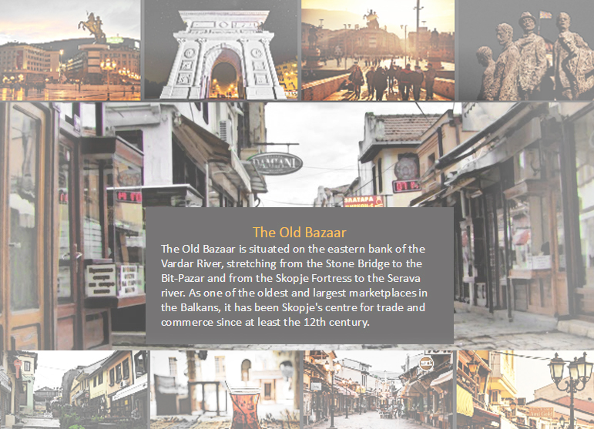
City centre page
represents the City Square, the Old town, the Kale Fortress, and all of the cultural institutions in their proximity

Slide 13
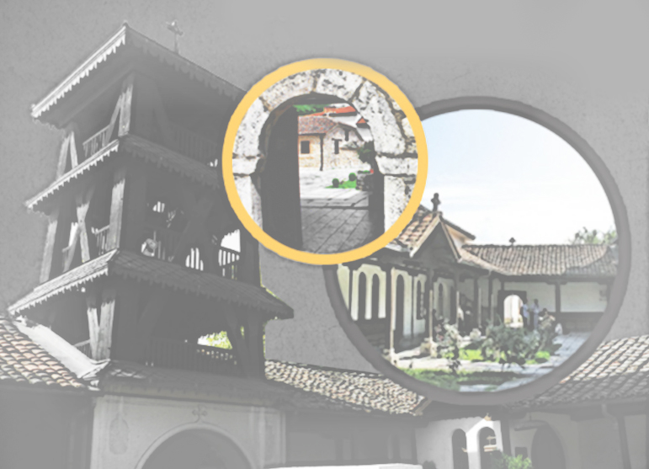
Temples page
incorporates the most significant churches and mosques in the city and its outskirts

Slide 14
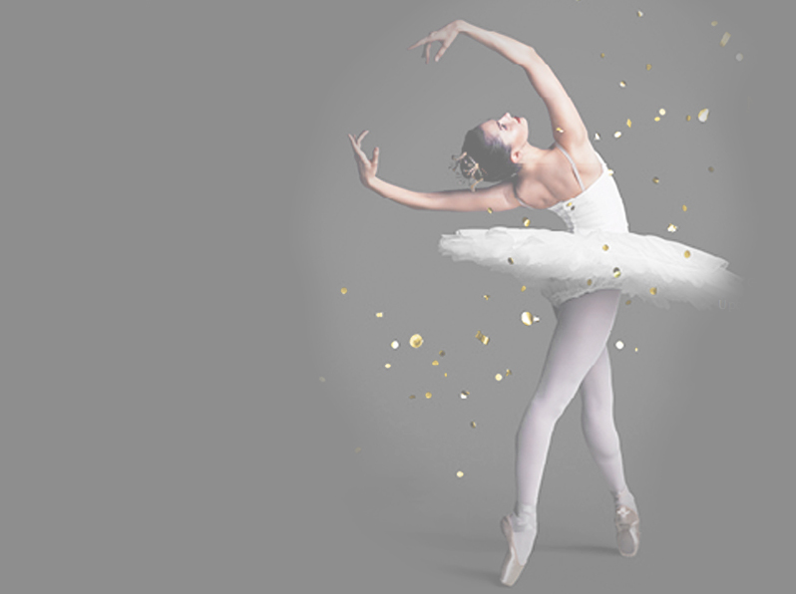
Theaters page
contains information, photos, videos, tours of the theaters, the Macedonian opera and ballet, and the cinemas in Skopje.

Slide 15
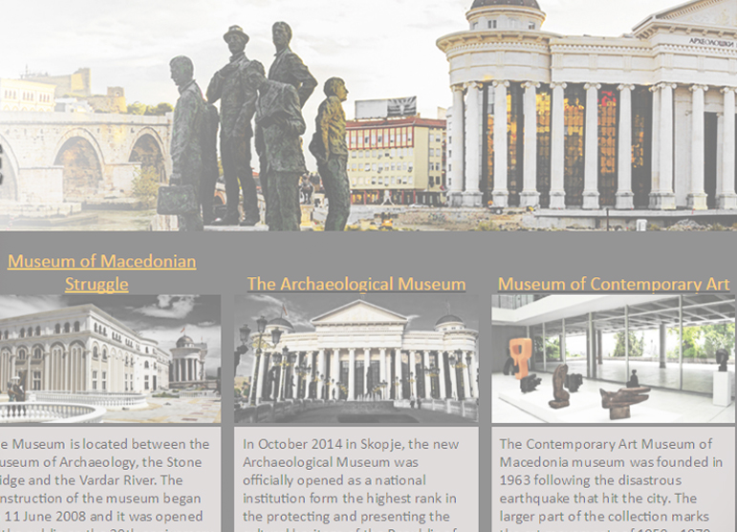
Museums page
Uses photos, text and a map to represent the 12 most popular museums in the city

Slide 16
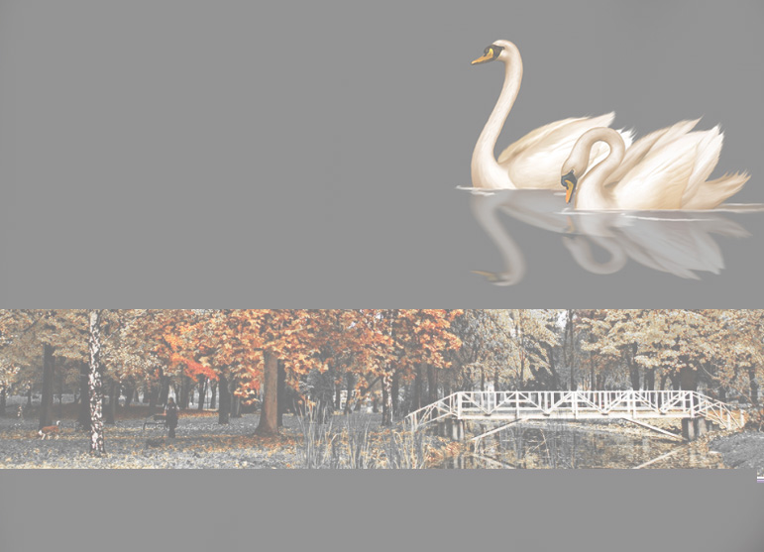
Outings page
represents the best outdoor attractions, among which are the city park and zoo, Matka Canyon and Mount Vodno.

Slide 17
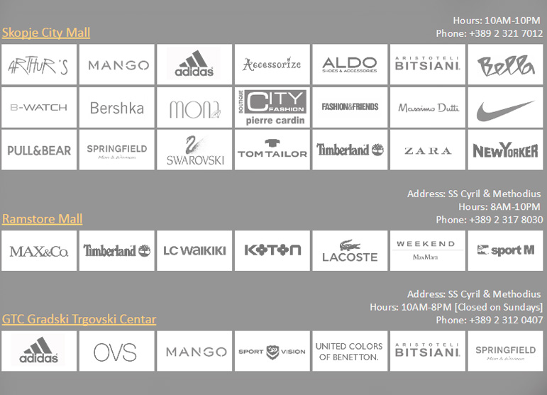
Shopping page
displays the shopping centers featuring their popular brands where each logo contains a link to the appropriate store

